Slide 1
Your Gut Sense
Does technology (and associated media) affect how you think?

Slide 2
Instructional Television
History of Ed Tech
EDC&I 510

Slide 3
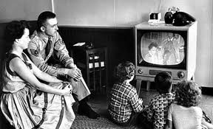
TV
First big communication technology to arrive with lots of fanfare, predictions
Initial predictions were grand: “People will watch theatre performances in their living rooms.”

Slide 4
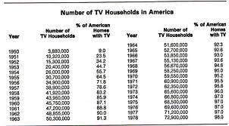
Rapid Spread of TV
Quick adoption by most US households
Reshapes entertainment industry
Many cultural artifacts generated very swiftly

Slide 5
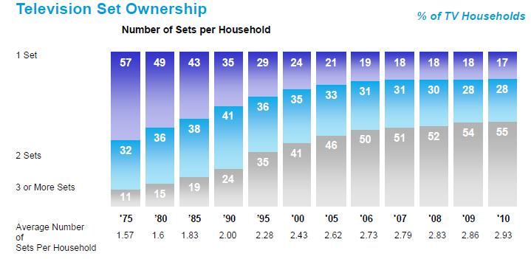
Merging into Everyday Life

Slide 6
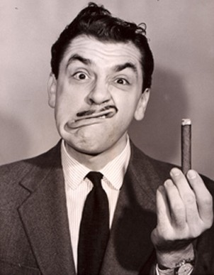
Developing a Visual Esthetic

Slide 7
Pervasive and Long-Term Cultural Consequences
Removing previous barriers between
Men’s and women’s spheres of activity
Political elites and the masses (elimination of the “smoky room”)
Adults and children
Joshua Meyrowitz, No Sense of Place (1986)

Slide 8
McLuhan’s Ideas
Canadian professor of Renaissance rhetoric
Most active in 1950s-70s
Famous for “the medium is the message” and “the global village”
But what does that mean…?
Understanding Media (1964)
“Hot” and “Cool” media

Slide 9
Hot and Cool
HOT
Extend one sense in high definition
User doesn’t have to work so hard to extract meaning (so: less mental engagement)
Film
Novels
Radio
Photography
COOL
Extend several senses in lower definition
Takes effort for user to extract meaning (so: more mental engagement)
TV
Comics

Slide 10
McLuhan’s Legacy
At death (1980), seen as something of a crank, media hypester, faux celebrity
Often not taken seriously as a communication, culture scholar
More recently, a rebound in interest (probably connected with Internet’s perceived effects)
Scholars with an education bent: Gavriel Salomon, David Olson, Michael Cole

Slide 11
Thinking about Instructional Uses
TV came into classroom at nearly same time it won wide acceptance in homes
Variety of different purposes for use
Regular instruction, as teacher substitute, in distance ed, for ed in non-school settings, etc.
Fairly rapid evolution over 30 years (1950-80)
Hardware costs, development of cheap VCRs, etc.
Big government programs pushed development
Sesame Street, etc.

Slide 12
Uses in Classroom
Early efforts at distance learning in higher ed
E.g.: Sunrise Semester
Popular, but very basic

Slide 13
K-12 Classroom Use
Teacher shortage in early 1960s (baby boom) led to many experiments with using TV to “substitute for the teacher”
Typically closed-circuit from one room of a building to another
Not highly successful – parents were suspicious

Slide 14
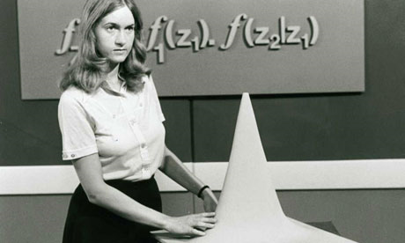
Distance Education
More successful, esp. in Great Britain with advent of Open University (1969)
Design, creation and distribution of materials (not just TV) was key
Worked best in situations with widely dispersed populations over big areas (Canada, Australia, USSR)

Slide 15
Sesame Street
Part of “Great Society” efforts to improve education, lift kids from poverty
Backed by serious research efforts
Active employment of visual effects in service of learning

Slide 16
Distinctive Characters, Settings
The Count

Slide 17
What Mattered
Careful design (attention to prior learning, developmental stages, etc.)
Capitalization on associations already made via entertainment TV (pixilation, etc.)
Constant comparison and contrast with high-production-value shows (commercials, etc.)
Value of self-confrontation
E.g., in teacher ed or any performance venue

Slide 18
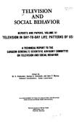
TV & Violence
Big national debate in 60s-70s
Surgeon General’s Report in 1972 attempted to settle question
(But still debated today)

Slide 19
What Didn’t Matter So Much
Exposure to negative stimuli in entertainment TV (ads, violence, etc.)
“Standard” production values (color, animation, etc.)
Physical arrangement of viewing environments

Slide 20
Questions that Faded with Time
Video as delivery vehicle for distance learning
Was very hardware-intensive in cf. to online
Complexity of delivering video signals
Spread of CCTV, then VCRs
Video as direct teacher substitute
Teacher supply and demand now better understood and monitored

Slide 21
What Was Left Unanswered
Impact of long term exposure to mediated materials (attention span, etc.)
Cf. wide use of Channel One & what kids recall
“Print is hard, TV is easy” Are they?
“Visual literacy” What is it?
Cf. current interest in “Digital Storytelling”
Is the Medium the Message?

Slide 22
Discussion Questions for Readings
Chu & Schramm
Compared with the research on film, where does the research on TV match up? Where is it different?
What was “conventional instruction” in the studies summarized?
What were some of the underlying motivations for using TV in instruction?

Slide 23
Clark (‘83, ’94)
“Mere vehicles…” Do you agree with this position (83, p. 445)? Why or why not?
Media attribute research (p. 451) – Are we still doing this sort of research today? Examples?
Invested mental effort (IME) work (p. 455) – Interaction with student ability levels – implications?
Efficiency vs. effectiveness (94, pp. 25-27) – Do you agree with Clark’s views?
Cf.: McLuhan’s ideas

Slide 24
Clark (‘01)
Cognitive load and mental effort (267-279) – Implications for other applications, subjects
How to design to prevent “Overconfidence default” (280-82)?
Motivation processes (“yin” and “yang”) – picture of learners and their motivations that emerges?

Slide 25
Salomon & Perkins
Effects with, of, and through technology –Examples of each?
Learning benefits of each?
“Effects through” and notion of activity systems: How does this match with current uses of social media? With support for learning ?

Slide 27
Games and Learning (for next week, 11/2)
If you play games, what are the instructional qualities or value that you see in your favorite games? What do you learn when you play?
If you don't play games, research or find a game that you are interested in and play it (or think of a game you used to play). What are/were the instructional qualities that you experienced, if any? What did you learn while playing?

